Slide 1
ADVANCE WEB PROGRAMMING WITH VUEJS
Irfan Maulana | Front End Developer

Slide 2

About Me
Name : Irfan Maulana
Position : Software Development Engineer
Role : Front End Developer
+ https://github.com/mazipan
+ https://mazipan.github.io/

Slide 3
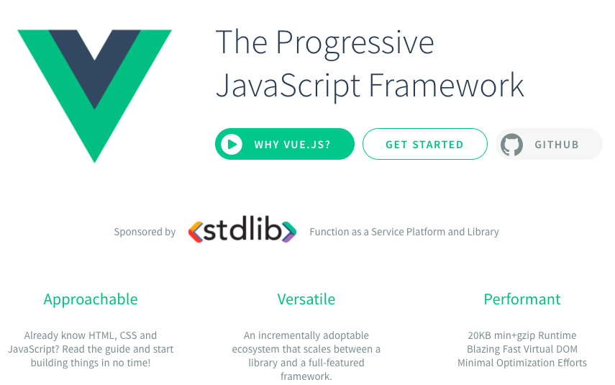
Vue.js Intro
Read more :
https://vuejs.org/

Slide 4
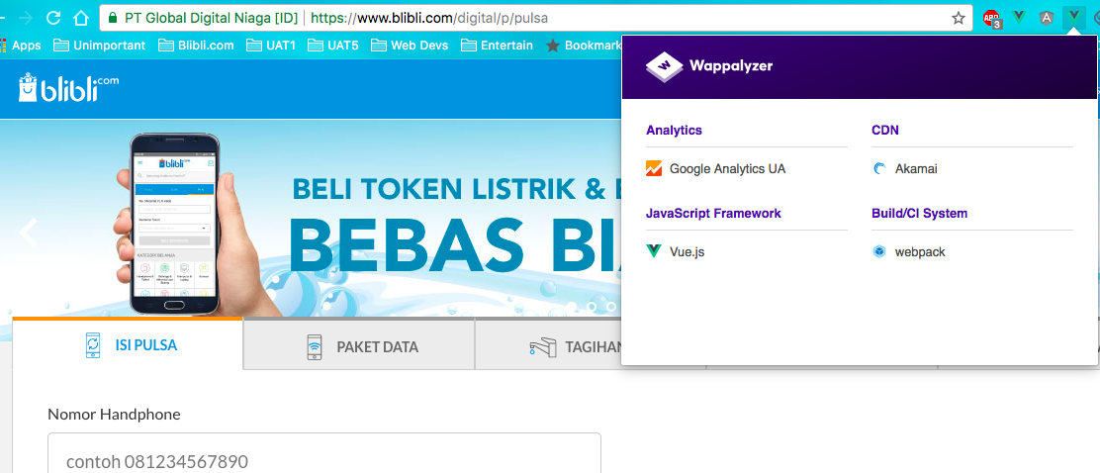
Vue.js in Blibli.com

Slide 5
Advance Web Application
+ Single Page Application
+ Hot Module Replacement
+ Frontend Routing
+ ES6+ Syntax and Linting
+ CSS Pre-processor and Autoprefixer
+ Unit Test and E2E
+ Build with minifier
+ State Management
+ i18n
+ Etc…

Slide 6
Prerequisites
+ Nodejs : https://nodejs.org/en/ (> 6.x)
+ NPM : >3
+ Git : https://git-scm.com/

Slide 7



Vue-CLI Skeleton
+ Vue CLI : https://github.com/vuejs/vue-cli
+ Webpack Template : https://github.com/vuejs-templates/webpack
+ LocaleTemplate : https://github.com/vuejs/vue-cli#local-templates

Slide 8
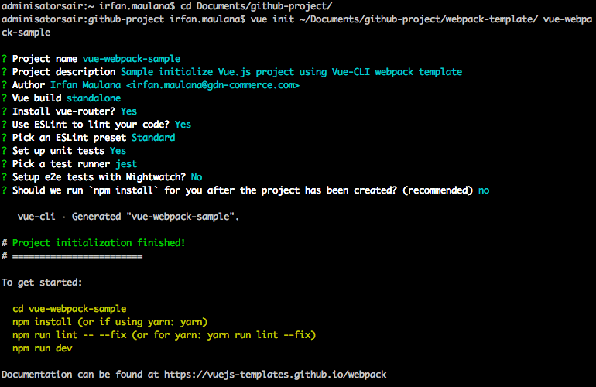
Creating Webpack Skeleton

Slide 9
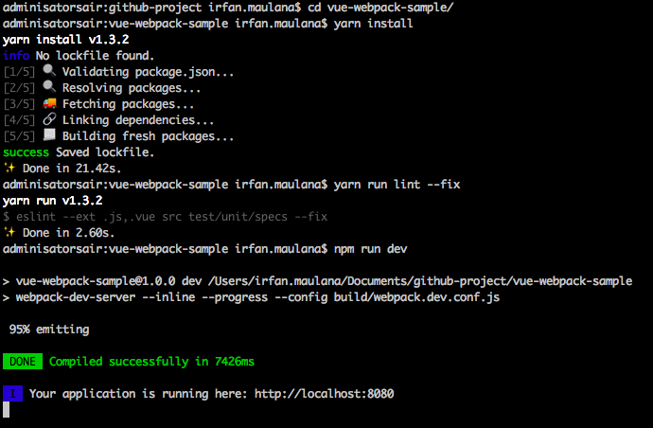
Install and Running Project

Slide 10
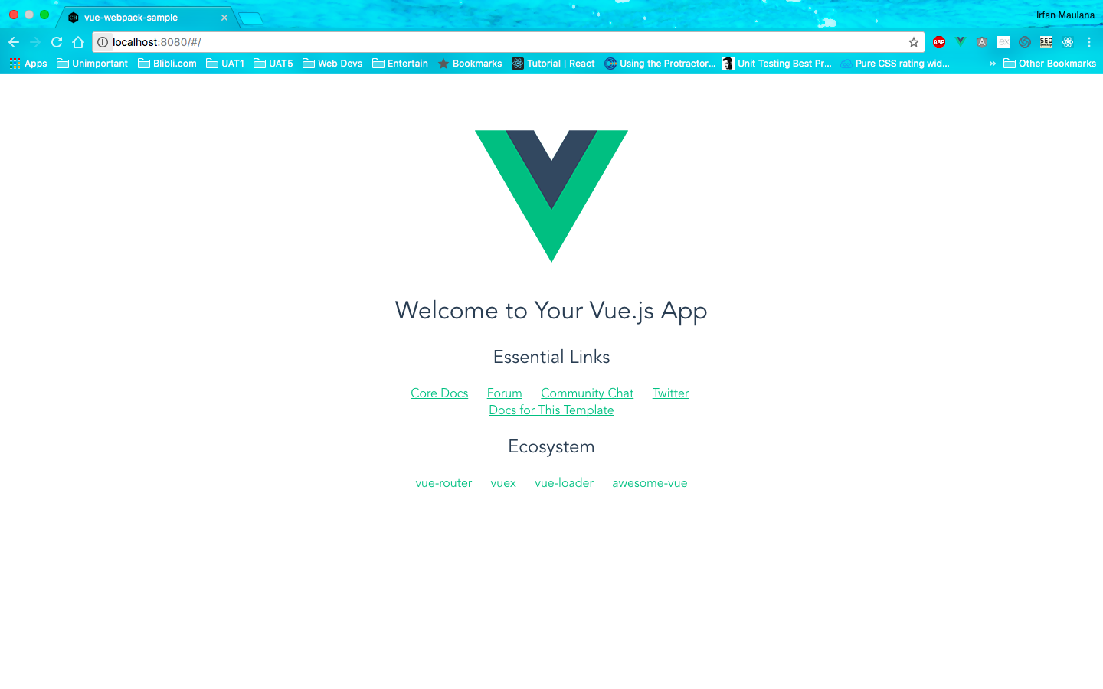
Open Your Browser

Slide 11
Learn Data Binding
Hands on…

Slide 12
Learn Computed and Watch
Hands on…

Slide 13
Learn Props and Events
Hands on…

Slide 14
Learn Routing
Hands on…

Slide 15
Learn make API Request
Hands on…

Slide 16
Learn State Management
Hands on…

Slide 17
Source code & learn from more example
Result from this session :
https://github.com/mazipan/vue-webpack-sample
See other projects :
https://github.com/mazipan?tab=repositories&language=vue

Slide 18
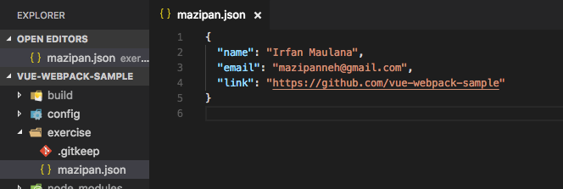
Learn by doing ☺
Find public API here : https://github.com/toddmotto/public-apis
And create your web application using Vue Webpack Template !!!
Fork this project : https://github.com/mazipan/vue-webpack-sample
Then add your identity and project link to exercise folder

